Slide 1
Lecture 04 Dynamic programming
Spring 2026
Zhihua Jiang

Slide 2
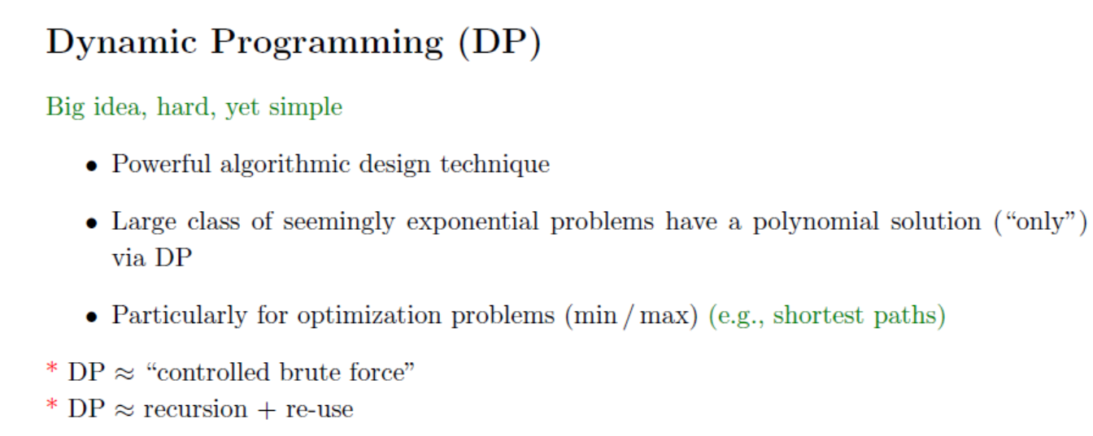

Slide 3
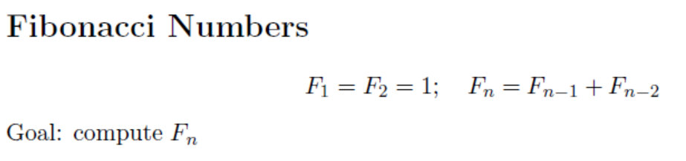
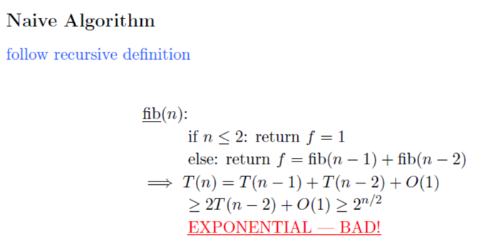

Slide 4
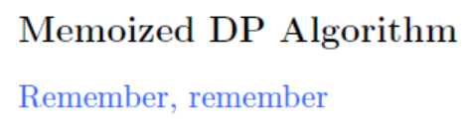
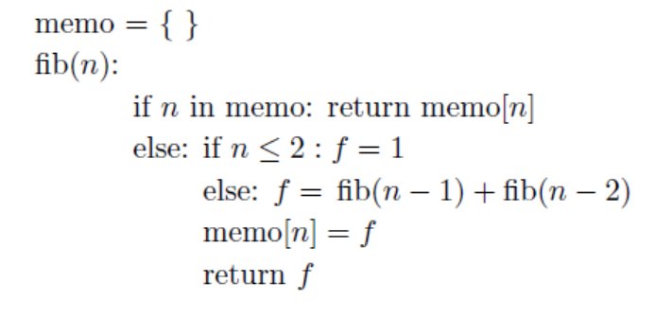
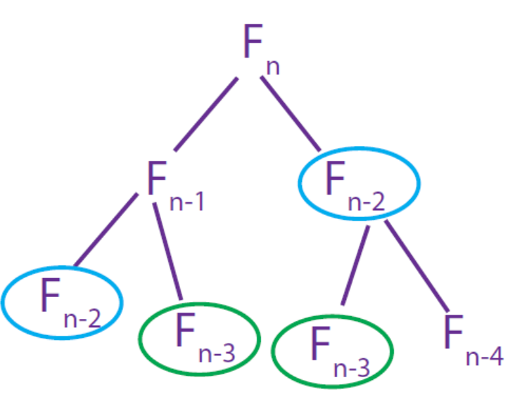

Slide 5
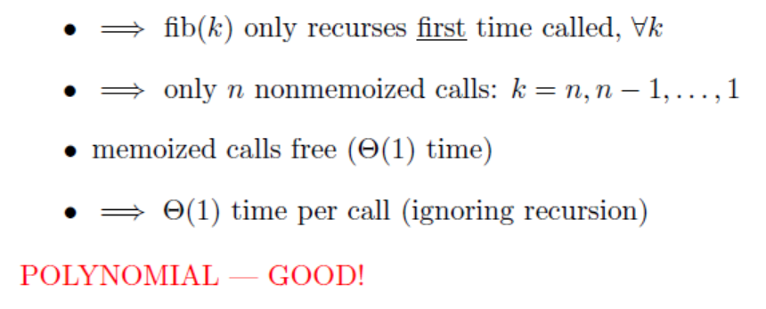

Slide 6
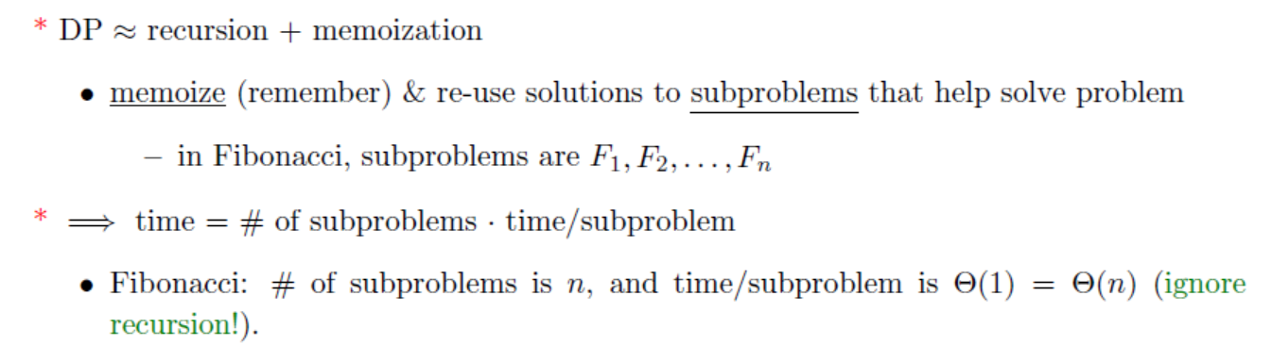

Slide 7
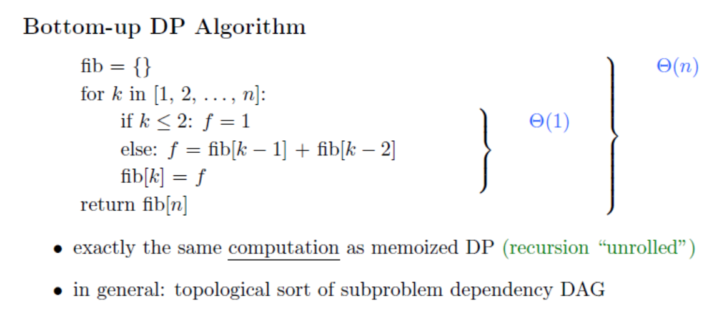

Slide 8
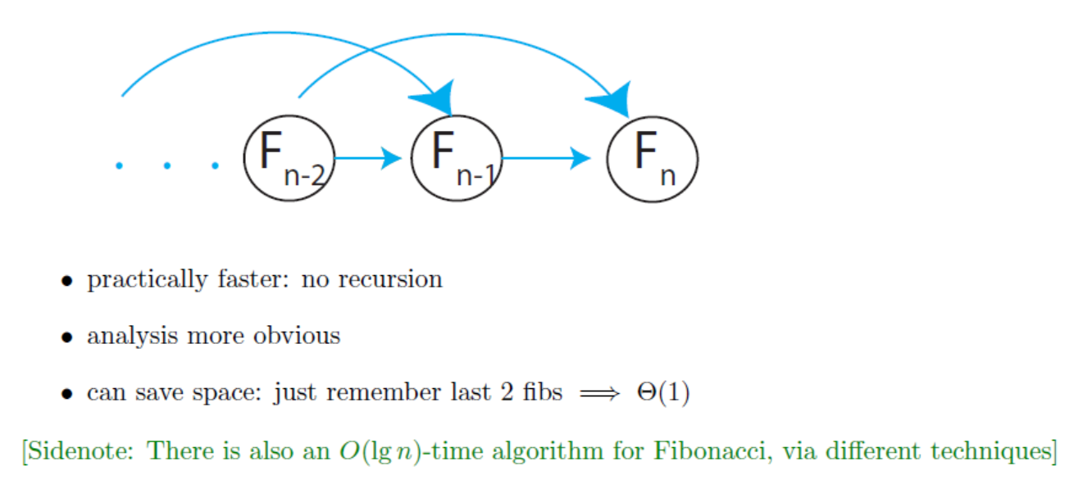

Slide 10
8
Notes:
flooring(n/2)=(n-1)/2

Slide 13
Chain matrix multiplication
Problem: multiply four matrices

Slide 14
Chain matrix multiplication
Matrix multiplication is associative.
Compute the product of four matrices in many different ways, depending on how parenthesize it.
Multiplying an m×n matrix by an n×p matrix takes mnp number multiplications.
The order of multiplications makes a big difference in the final running time.

Slide 15
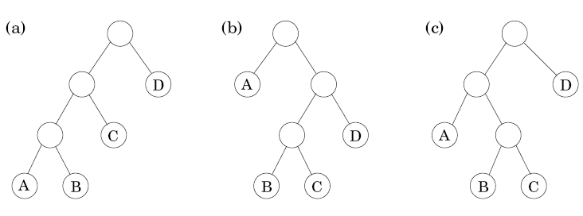
6.5 Chain matrix multiplication
How to determine the optimal order for A₁× A₂×… × A_{n}, where A_{i} with dimension m_{i-1}× m_{i}?
A particular parenthesization = a binary tree
Leaf: matrix
Root: product
Interior node: intermediate product
The number of binary trees is exponential in n (n leaves)
Notes:
#tree = (n-1)!=omega(2^(n-1))

Slide 16
Chain matrix multiplication
The optimal substructure property: for a tree to be optimal, its subtree must also be optimal.
Subproblem corresponding to a subtree: product of the form A_{i}× A_{i+1}×… × A_{j}
For 1≤i ≤j≤n, the optimal value array
C(i,j) = minimum cost of multiplying A_{i}× A_{i+1}×… × A_{j}
The splitting point k: split the product into two pieces, of the form A_{i}× … × A_{k} and A_{k+1}×… × A_{j}
The total cost is the cost of these two partial products plus the cost of combining them

Slide 17
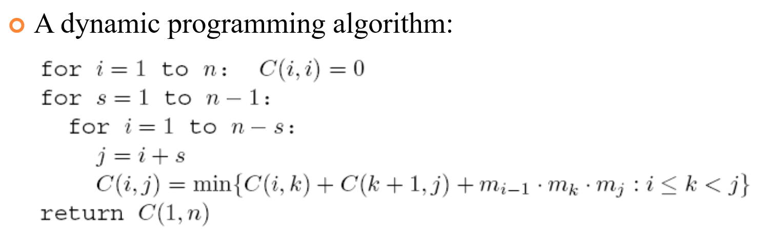
How to determine the optimal order for A₁× A₂×… × A_{n}, where A_{i} with dimension m_{i-1}× m_{i}?
Notes:
s=n-1 <-> i=1, j=n
for i=1 to n
for j=i+1 to n
wrong ordering!
for s=1 to n-1
for I =1 to n-s
j=i+s
s + 1 = length(chain)

Slide 18
Edit distance
The distance between two strings: the extent to which they can be aligned.
Example: SNOWY vs. SUNNY
Cost of an alignment: the number of columns in which the letters differ.
Edit distance: the cost of their best alignment, i.e., the minimum number of edits – insertions, deletions, and substitutions – needed to transform the first string into the second string.
18
Notes:
Worst-case of substitution: SANOWY → SNOWY, cost=1 (1 insertion)

Slide 19
Edit distance
What are the subproblems?
Property: there is an ordering on the subproblems, and a relation that shows how to solve a subproblem given the answers to “smaller” subproblems, i.e., subproblems that appear earlier in the ordering.
Subproblem E(i, j): the edit distance between some prefix of the first string x[1..i] and some prefix of the second string y[1..j]
19

Slide 20
Edit distance
Smaller problems for E(i,j): E(i-1,j), E(i,j-1), E(i-1,j-1)
Try all and
Pick best!
20

Slide 21
Edit distance
A dynamic programming solution
Fill a table row by row, and left to right within each row
The time complexity: O(mn)

Slide 22
Edit distance
2026/4/16

Slide 23
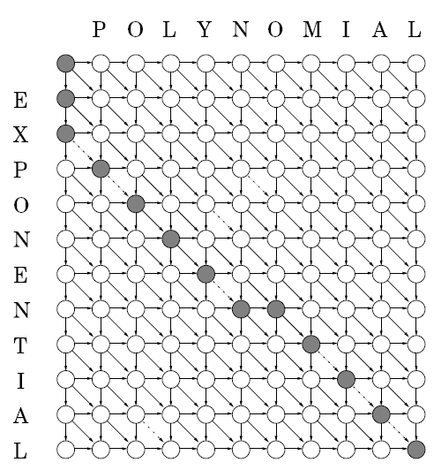
Edit distance
2026/4/16
Edits
Move down → deletion
Move right → insertion
Diagonal move → match or substitution
e.g. EXPONENTIAL→POLYNOMAIL

Slide 24
Knapsack
Problem description: a total weight W, n items to pick, of weight w₁,…, w_{n} and value v₁,…, v_{n} , what is the most valuable combination of items which can fit into the bag?
Example: W=10
Unlimited quantities of each item:
optimal solution $48
48 = 1 × #1+2 ×#4
One of each item:
optimal solution $46
46= 1 × #1+1 ×#3
#
#
#
#

Slide 25
Knapsack
Knapsack with repetition
Subproblem: smaller knapsack capacities w≤W
K(w)=maximum value achievable with a knapsack of capacity w
A dynamic programming solution (W and all w need to be integers):
The time complexity: O(nW)

Slide 26
6.4 Knapsack
Knapsack without repetition
Subproblem: smaller knapsack capacities w≤W and fewer items (items 1,2,…,j, for j≤n)
K(w, j)=maximum value achievable with a knapsack of capacity w and items 1,…,j
A dynamic programming solution:
The time complexity: O(nW)

Slide 27

Max{K(4)+30,K(7)+14,K(6)+16,K(8)+9}
Max{K(3)+30,K(6)+14,K(5)+16,K(7)+9}
Max{K(2)+30,K(5)+14,K(4)+16,K(6)+9}
w | 1 | 2 | 3 | 4 | 5 | 6 | 7 | 8 | 9 | 10
K(w) | 0 | 9 | 14 | 18 | 23 | 30 | 32 | 39 | 44 | 48
Max{K(0)+9}
Max{K(0)+14,K(1)+9}
Max{K(1)+14,K(0)+16,K(2)+9}
Max{K(2)+14,K(1)+16,K(3)+9}
Max{K(0)+30,K(3)+14,K(2)+16,K(4)+9}
Max{K(1)+30,K(4)+14,K(3)+16,K(5)+9}

Slide 28
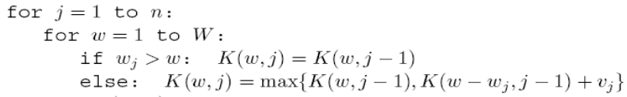
W j | 0 | 1 | 2 | 3 | 4 | 5 | 6 | 7 | 8 | 9 | 10
0 | 0 | 0 | 0 | 0 | 0 | 0 | 0 | 0 | 0 | 0 | 0
1 | 0 | 0 | 0 | 0 | 0 | 0 | 30 | 30 | 30 | 30 | 30
2 | 0 | 0 | 0 | 14 | 14 | 14 | 30 | 30 | 30 | 44 | 44
3 | 0 | 0 | 0 | 14 | 16 | 16 | 30 | 30 | 30 | 44 | 46
4 | 0 | 0 | 9 | 14 | 16 | 23 | 30 | 30 | 39 | 44 | 46
c

Slide 29
Independent sets in trees
Independent set: subset of nodes S ⊂ V, and there are no edges between them
Finding the largest independent set in a graph is intractable
However, it can be solved in linear time when the graph is a tree, using dynamic programming
Algorithm:
Start by rooting the tree at any node r. Each node defines a subtree.
The goal is I(r):
I(u) = size of largest independent set of subtree hanging from u
If know I(w) for all descendants w of u, then compute I(u):

Slide 30
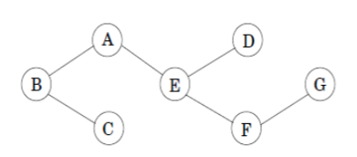
Independent sets in trees
The number of subproblems: O(|V|)
The running time: O(|V|+|E|)
I(G)=1
I(D)=1
I(F)=max{1,1}=1
I(E)=max{1+1,1+1}=2
I(C)=1
I(A)=max{1+2,2}=3
I(B)=max{1+2,3+1}=4
Notes:
left: pick itself
right: pick all children

Slide 31
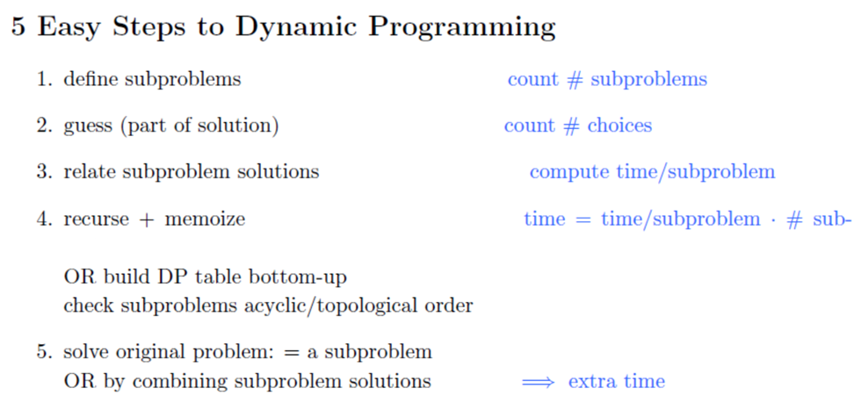

Slide 32
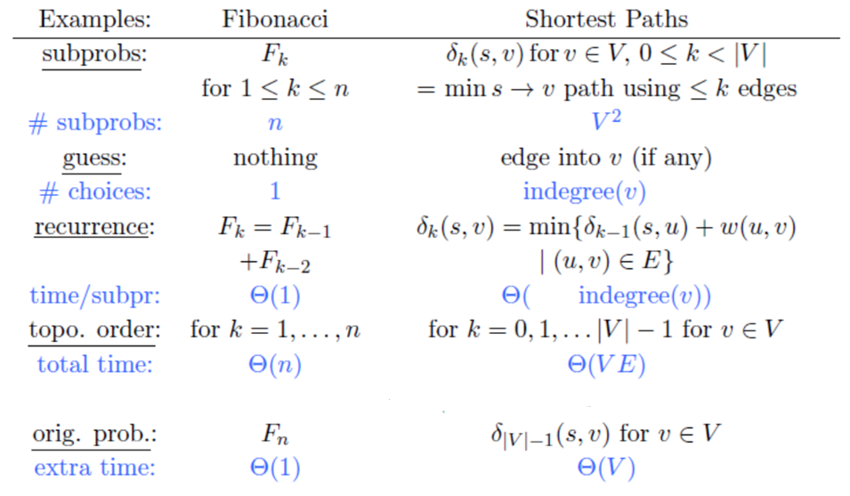

Slide 33
Exercise 1
Notes:
palindromic
英 [ˌpælɪn'drɒmɪk]
symmetric

Slide 34
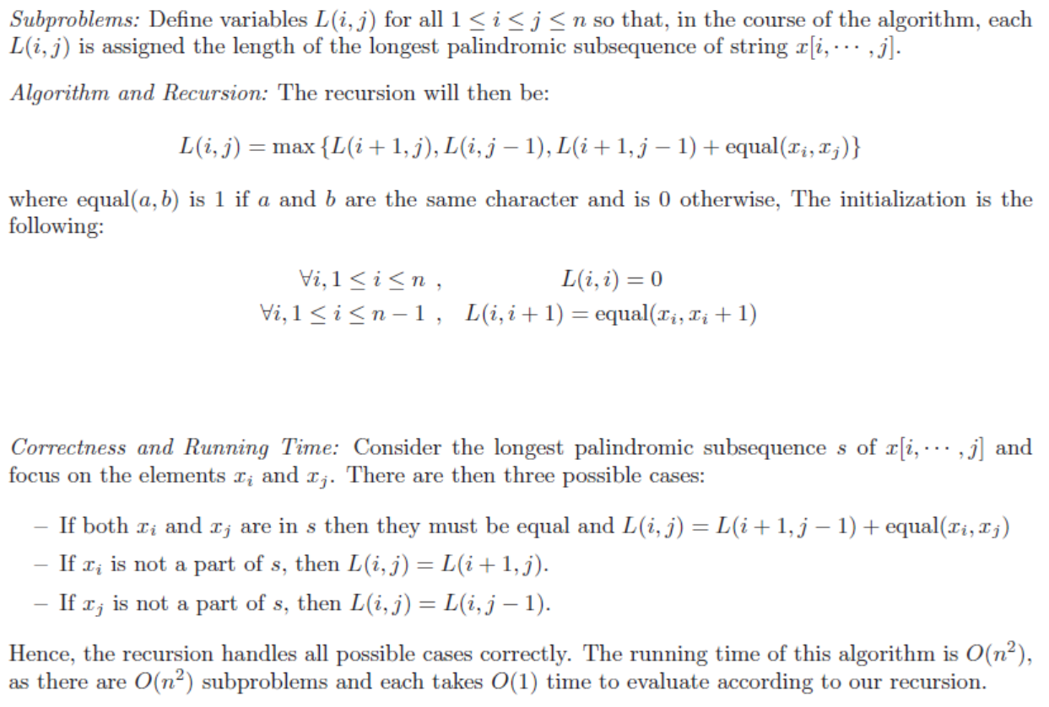
x_{i+1}
For s=1 to n-1
for i=1 to n-s
j=i+s
Notes:
palindromic
英 [ˌpælɪn'drɒmɪk]

Slide 35
i
 | A | C | G | T | G | T | C | A | A | A | A | T | C | G
A | 0
C | 0 | 0
G | 0 | 0 | 0 |  |  |  | (i, j-1) | (i+1, j-1)
T | 0 | 0 | 0 | 0 |  |  | (i,j) | (i+1, j)
G | 1 | 1 | 1 | 0 | 0
T |  | 1 | 1 | 1 | 0 | 0
C |  |  | 1 | 1 | 0 | 0 | 0
A |  |  |  | 1 | 0 | 0 | 0 | 0
A |  |  |  |  | 1 | 1 | 1 | 1 | 0
A |  |  |  |  |  | 1 | 1 | 1 | 1 | 0
A |  |  |  |  |  |  | 2 | 2 | 1 | 1 | 0
T |  |  |  |  |  |  |  | 2 | 1 | 1 | 0 | 0
C |  |  |  |  |  |  |  |  | 1 | 1 | 0 | 0 | 0
G |  |  |  |  |  |  |  |  |  | 1 | 0 | 0 | 0 | 0
j

Slide 36
I
 | A | C | G | T | G | T | C | A | A | A | A | T | C | G
A | 0
C | 0 | 0
G | 0 | 0 | 0
T | 0 | 0 | 0 | 0
G | 1 | 1 | 1 | 0 | 0
T | 1 | 1 | 1 | 1 | 0 | 0
C | 2 | 2 | 1 | 1 | 0 | 0 | 0
A | 3 | 2 | 1 | 1 | 0 | 0 | 0 | 0
A | 3 | 2 | 1 | 1 | 1 | 1 | 1 | 1 | 0
A | 3 | 2 | 1 | 1 | 1 | 1 | 1 | 1 | 1 | 0
A | 3 | 2 | 2 | 2 | 2 | 2 | 2 | 2 | 1 | 1 | 0
T | 3 | 3 | 3 | 3 | 3 | 3 | 2 | 2 | 1 | 1 | 0 | 0
C | 4 | 4 | 3 | 3 | 3 | 3 | 3 | 2 | 1 | 1 | 0 | 0 | 0
G | 4 | 4 | 4 | 4 | 4 | 3 | 3 | 2 | 1 | 1 | 0 | 0 | 0 | 0
J

Slide 37
Exercise 2
V(G)=0
V(D)=0
V(F)=min{1,1+0}=1
V(E)=min{2+0,1+1}=2
V(C)=0
V(A)=min{1+1,1+2}=2
V(B)=min{2+2,1+2}=3
Best cover: {B, E, G} or {B, E, F}

Slide 39
Exercise 3

Slide 40
Notes:
5,15,-30,10,-5,40,10
D(1)=5
D(1)=20
D(1)=0
D(1)=10
D(1)=5
D(1)=45
D(1)=55

Slide 41
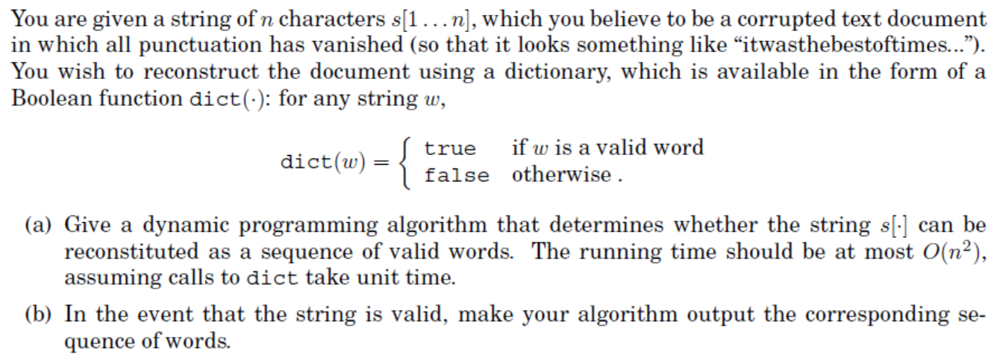
Exercise 4

Slide 42
